Slide 1

Ai Assistance for doctor and Patients
Presented By: Deepak Gariya

Slide 2
Introduction
Overview of the project: An AI-powered application leveraging Large Language Model (LLM) technology to assist doctors by analyzing medical images and providing detailed reports.
Importance of AI in healthcare: AI processes vast amounts of data quickly and accurately, aiding in diagnostics, treatment planning, and patient care.
Brief introduction to medical image analysis: Examining medical images (like X-rays, MRIs, CT scans) to detect abnormalities, diseases, and conditions.

Slide 3
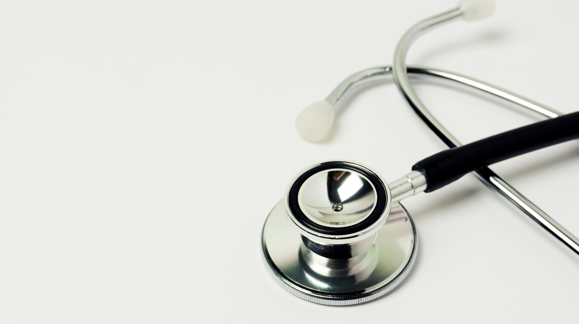
Objectives
Provide accurate medical image analysis: The primary goal is to ensure high accuracy in analyzing medical images. This involves using advanced AI models to detect even subtle anomalies that could indicate serious health issues.
Assist doctors in diagnosis: By offering a second opinion, the AI supports healthcare professionals in making informed decisions. This is particularly valuable in complex cases where human error is a risk.
Enhance patient care with AI recommendations: The application not only provides analysis but also suggests further tests or treatment options, thereby facilitating a more comprehensive approach to patient care.

Slide 4
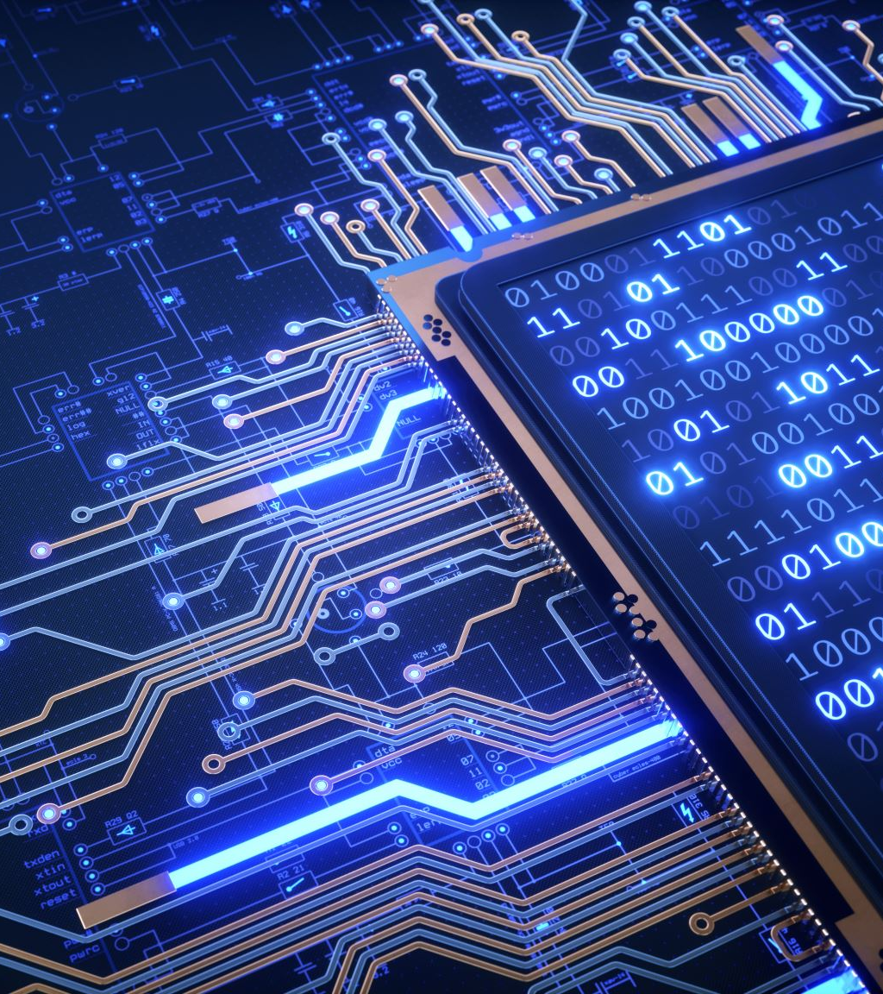
Technology Stack
Programming Language: Python: Python is a widely-used programming language in the fields of data science and AI due to its simplicity and versatility.
Framework: Streamlit: Streamlit is an open-source framework specifically designed for building web applications for data science and machine learning projects.
AI Model: Generative AI by Google (LLM): This project utilizes Google's Generative AI, a powerful language model capable of processing and generating text.
Additional Libraries: Pathlib: Pathlib is a Python library that provides an easy-to-use interface for file system paths.

Slide 5
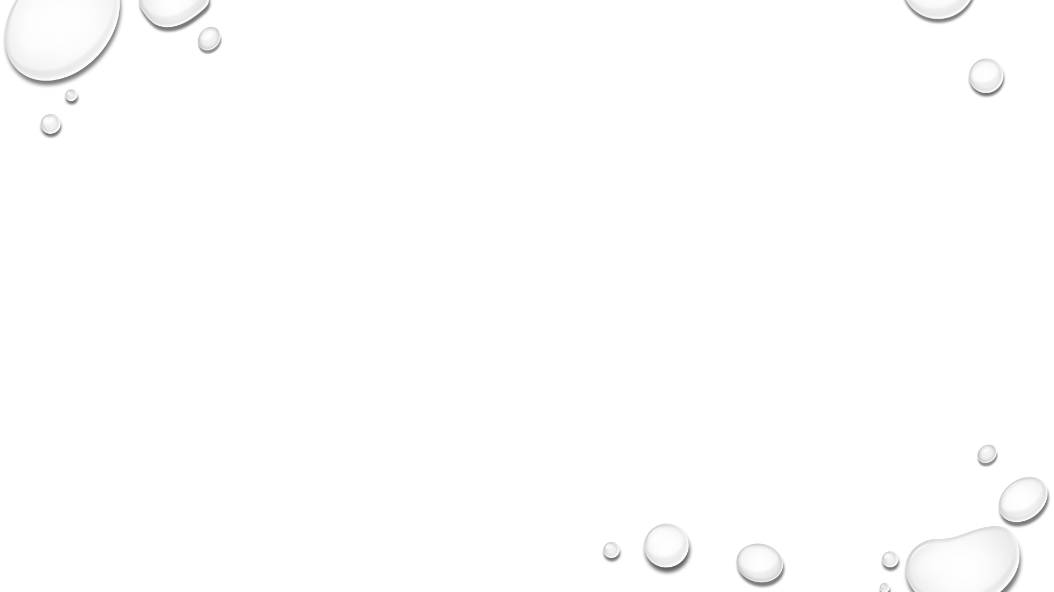
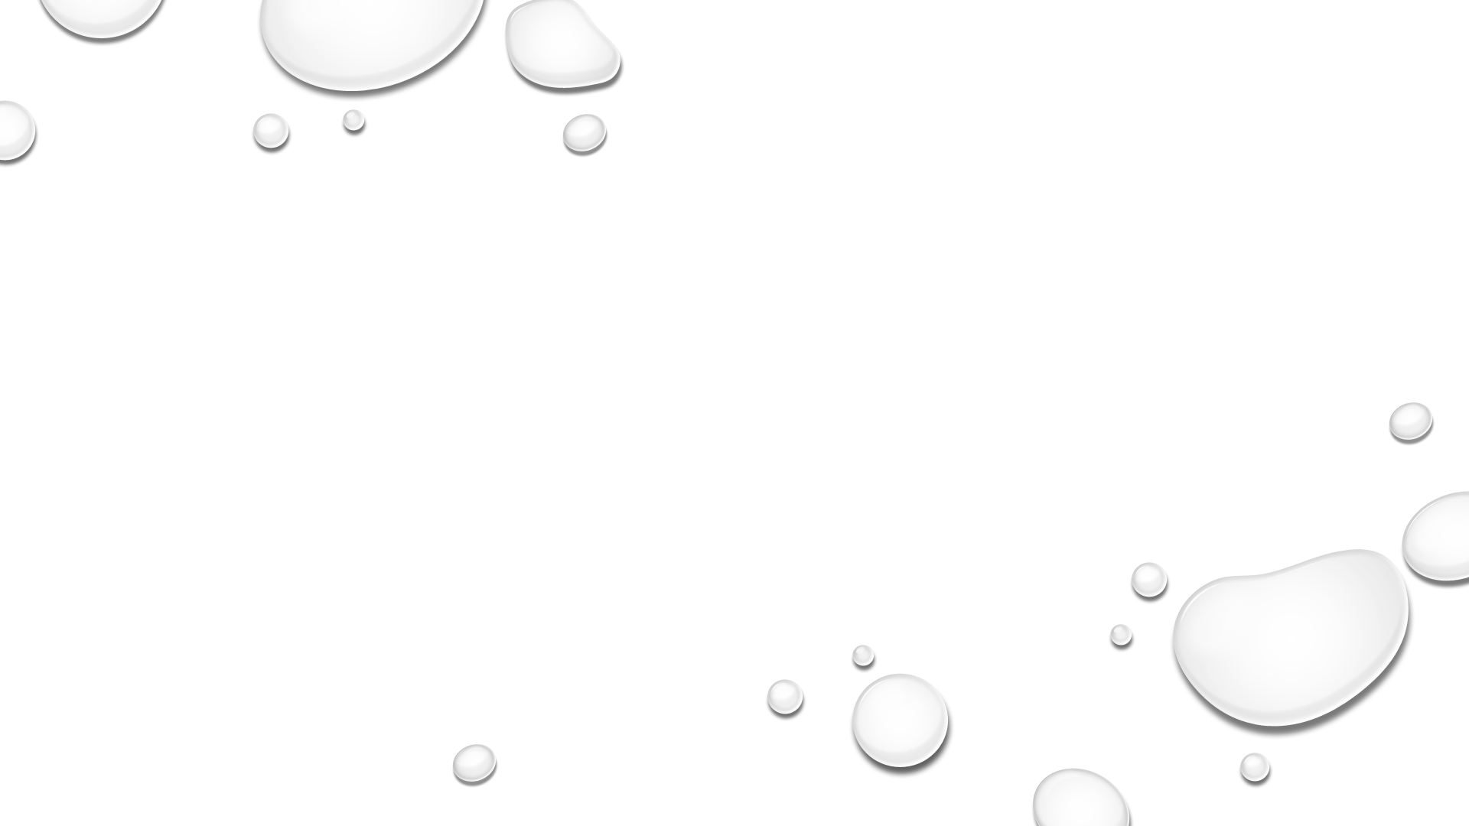
System Architecture
User Uploads Medical Image:
Users can easily upload medical images through a user-friendly web interface. Supported formats include PNG, JPEG, and JPG.
LLM Processes the Image:
The Generative AI model analyzes the uploaded imag to identify potential anomalies or health issues. This involves using advanced algorithms to interpret visual data.
Outputs Detailed Analysis:
The AI generates a comprehensive report that includes:
Detailed Analysis: In-depth examination of the uploaded image.
Finding Report: Specific anomalies or issues detected in the image.
Recommendations and Next Steps: Suggested actions based on findings (e.g., further tests).
Treatment Suggestions: Possible interventions or treatments relevant to the detected issues.

Slide 6
Key Features
Image upload functionality: Users can easily upload medical images using a straightforward interface, which enhances user experience and encourages engagement with the application.
AI-generated medical image analysis: The application utilizes the power of AI to provide in-depth analyses of the uploaded images, ensuring high accuracy and reliability in the findings.
Downloadable analysis report: After analysis, users can download a detailed report of the findings in text format, allowing for easy sharing and review of the results with colleagues or patients.
Feedback collection: The application includes a feature that enables users to submit feedback on the analysis provided. This helps improve the model's performance over time and enhances user satisfaction.

Slide 7

Demo/Code Walkthrough
Code breakdown:
Importing libraries and configuring the LLM: Import necessary libraries and configure the AI model with an API key and settings.
Setting up Streamlit interface: Create a user-friendly interface with Streamlit for uploading images and displaying results.
Handling image upload and analysis generation: Handle image uploads, process them, and generate analysis using the LLM.
Displaying and downloading the analysis report: Display the analysis on the web app and provide an option to download the report.

Slide 8
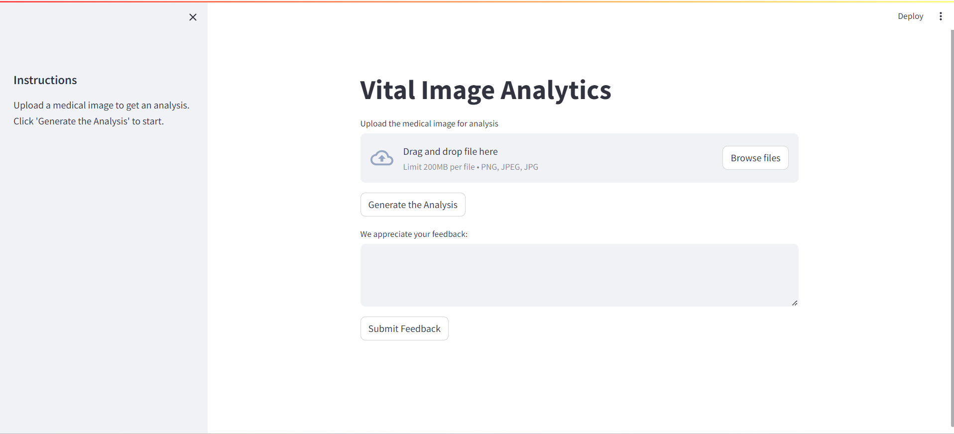
Interface:

Slide 9
Benefits
Saves time for doctors: Automates the image analysis process, allowing doctors to focus on patient care.
Provides second opinion: Offers an additional layer of analysis, supporting doctors in making accurate diagnoses.
Enhances diagnostic accuracy: LLM can detect subtle anomalies that might be missed by human eyes.
Improves patient outcomes: Timely and accurate analysis leads to better treatment decisions and patient care.

Slide 10
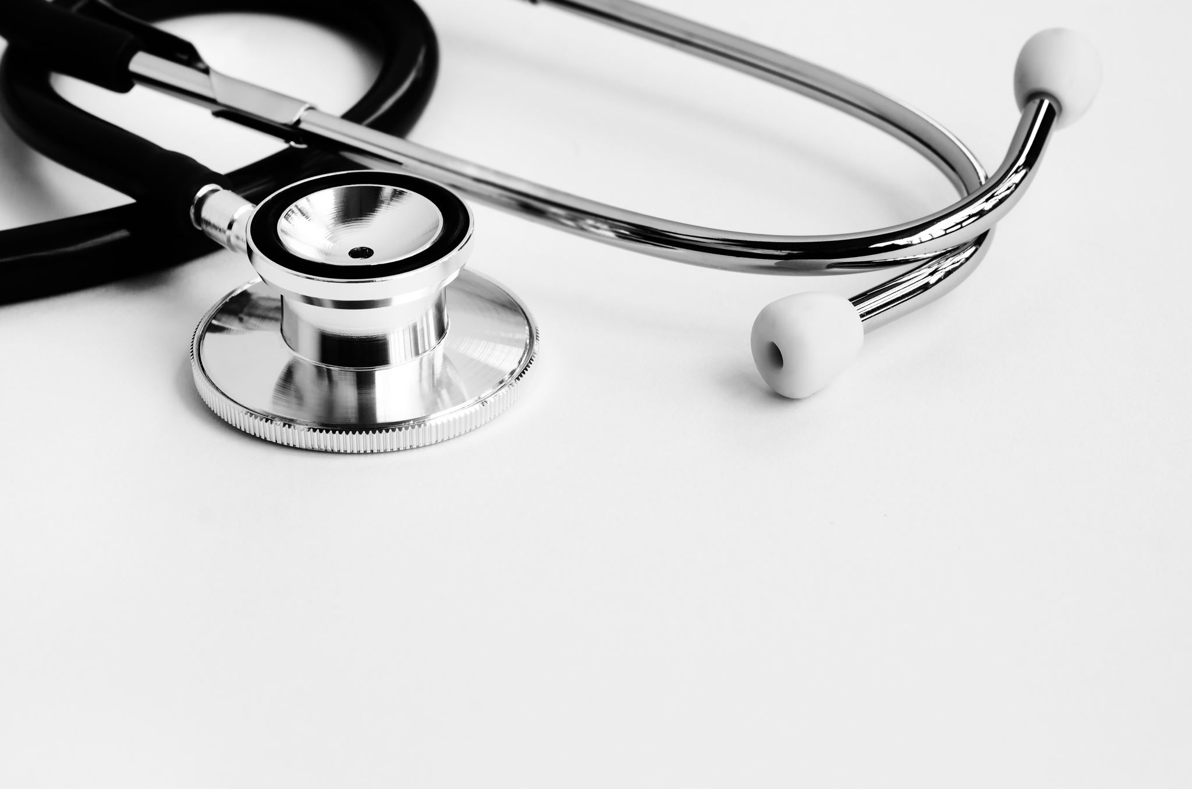
Future Work
Enhance LLM for more accurate analysis: Continuously train the LLM with additional datasets to improve its performance and accuracy in analyzing diverse medical images.
Expand to other types of medical images: Extend the application's capabilities to analyze other medical imaging modalities, such as MRI scans and CT scans, broadening its applicability in clinical settings.
Integrate with hospital systems: Linking the application with hospital information systems (HIS) can facilitate seamless data flow and integration, enhancing usability and efficiency in medical environments.

Slide 11
Thankyou

